Slide 1
Azure Data Services Demo

Slide 2



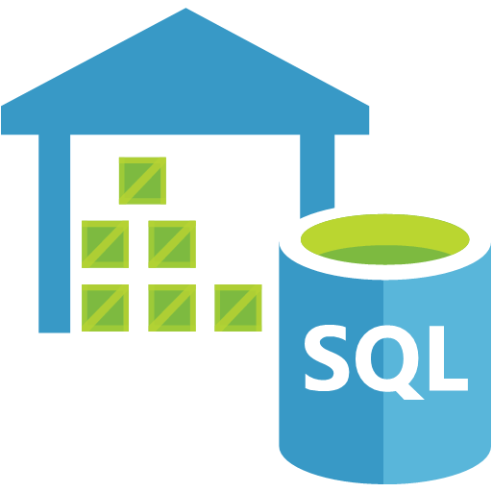




Demo Architecture
Machine Learning
Analytics
Store
Ingest

Slide 3
Ingest Data
Extract and Load
Store
Ingest

Slide 4

Ingest Data
Extract and Load
Store
Data Set
Data Set
Linked
Service
Linked
Service
Ingest
COPY
Activity

Slide 5
Ingest Data
Transform Data
Store
Ingest

Slide 6
Big data analysis
Azure Data Lake Analytics
Analytics
Store
Ingest

Slide 7
Big data analysis
HDInsight
Analytics
Store
Ingest

Slide 8
Big data analysis
SQL Data Warehouse
Analytics
Store
Ingest

Slide 9
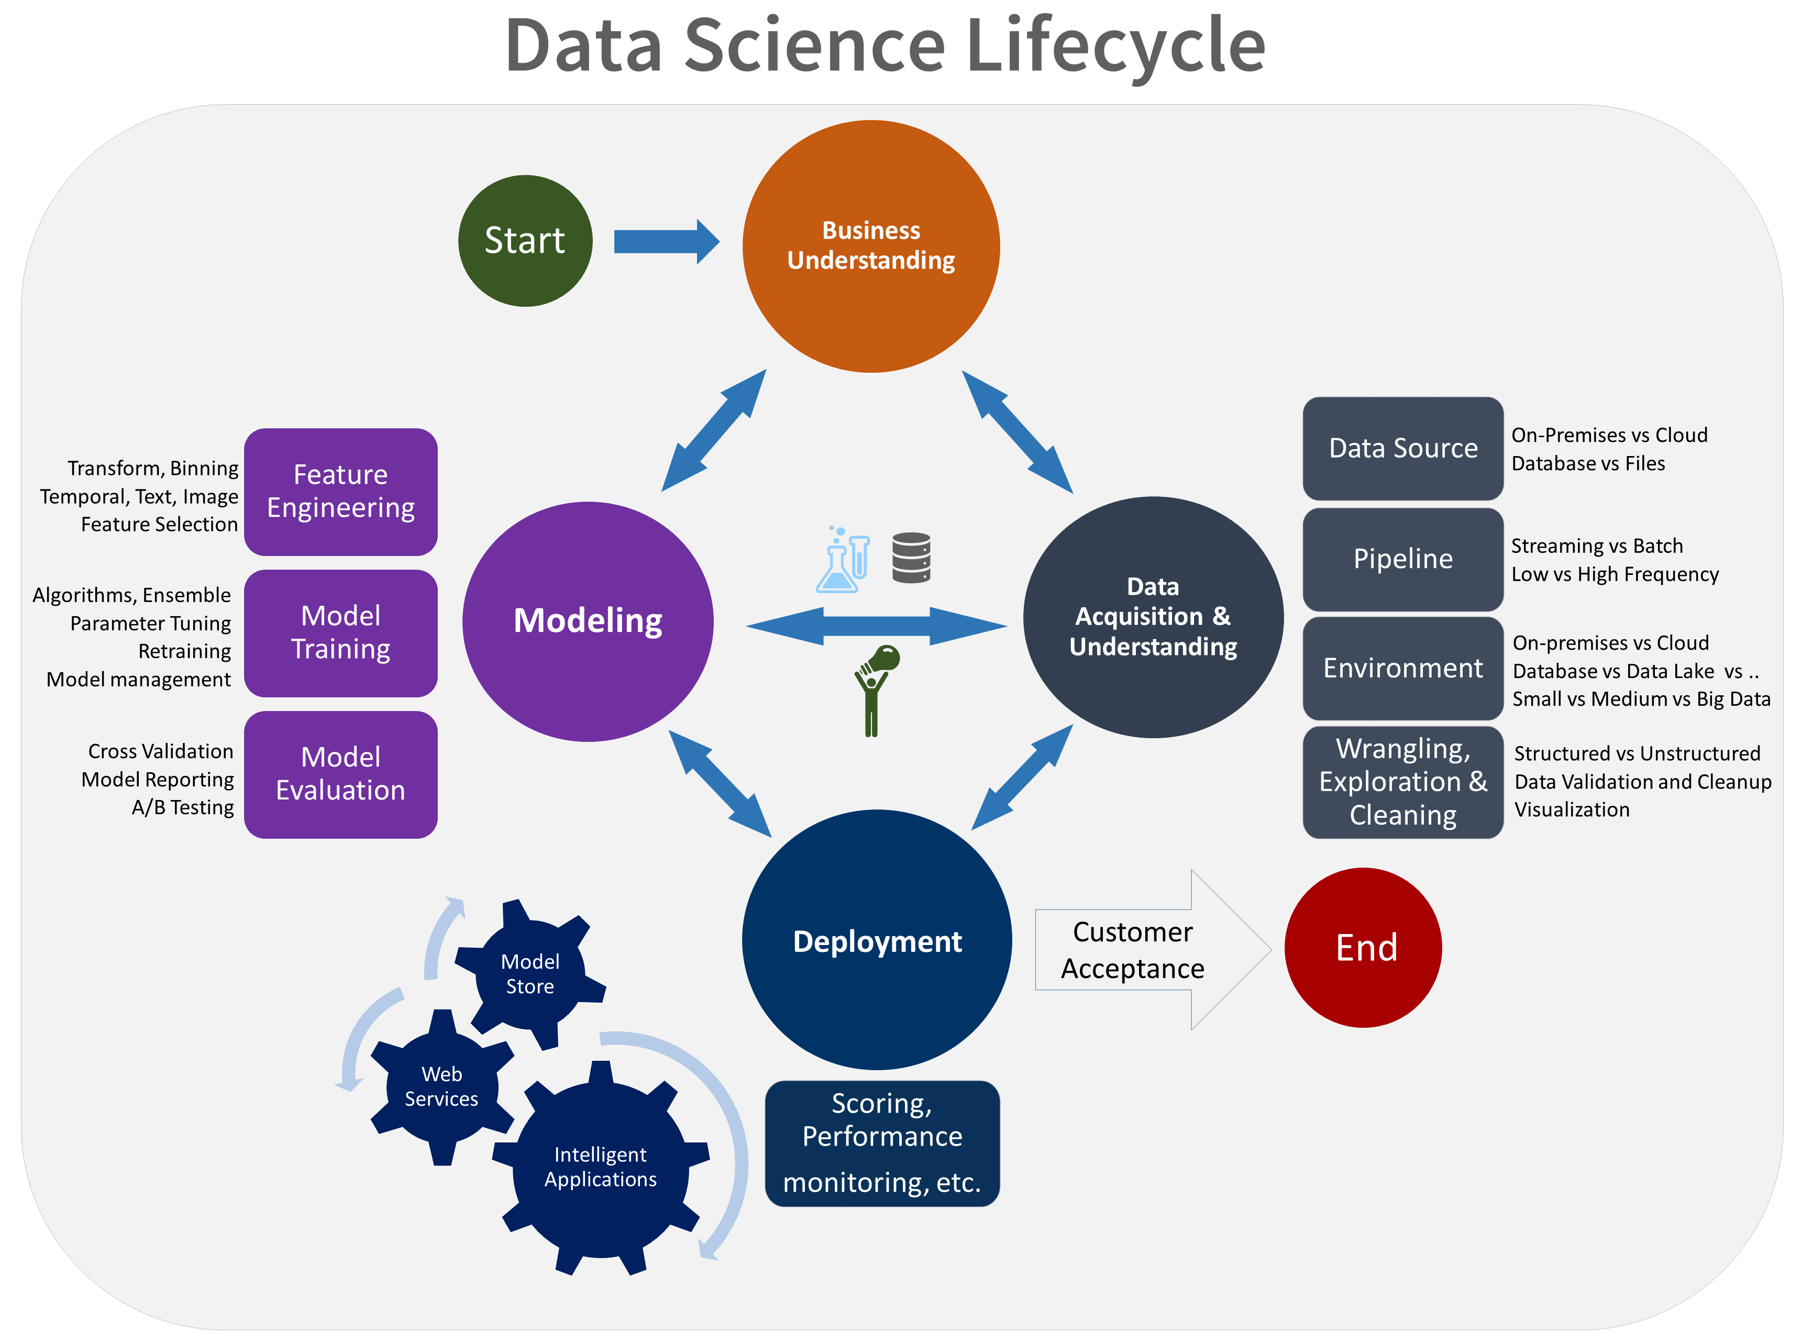

Slide 10
TDSP (Team Data Science Process)
Business Understanding

Slide 11

TDSP (Team Data Science Process)
Data Acquisition and Understanding
Machine Learning
Analytics
Store
Ingest

Slide 12




Analyze data in real-time
Stream Analytics
Analytics
Store
Ingest

Slide 13

Analyze data in real-time
Stream Analytics
Analytics
Store
Ingest

